Slide 1
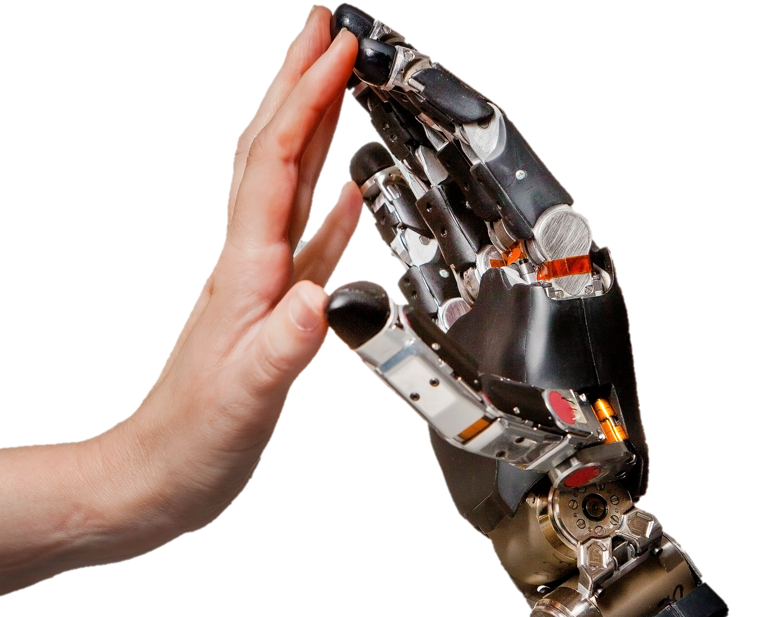
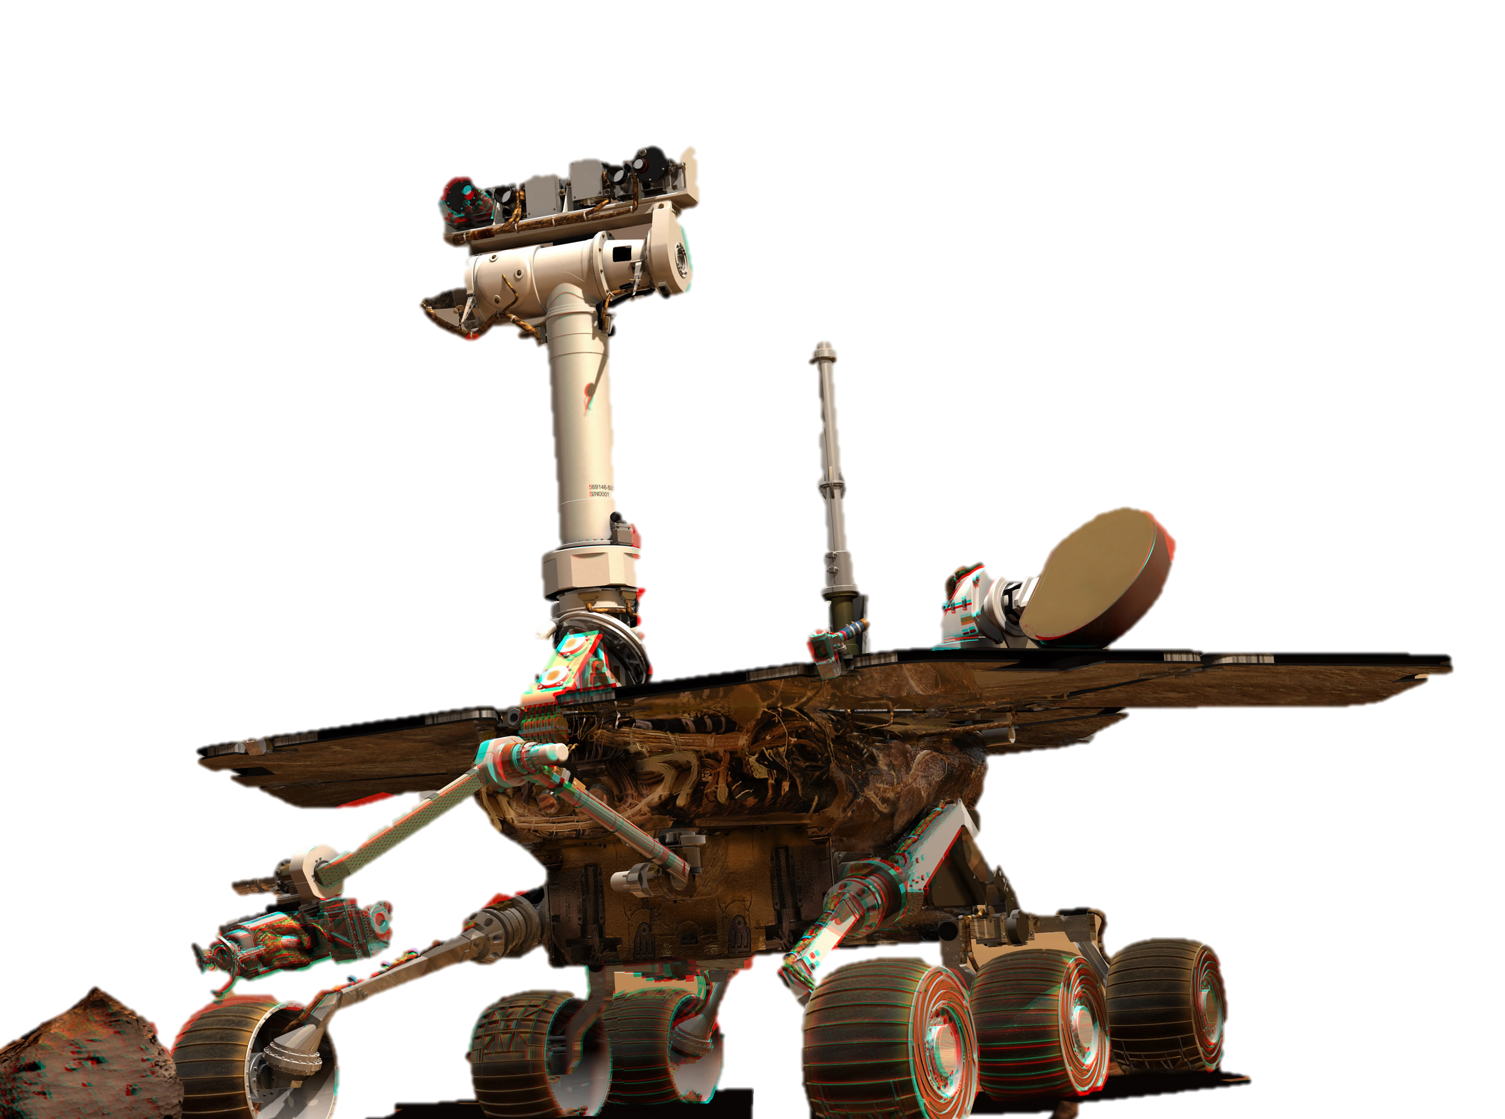
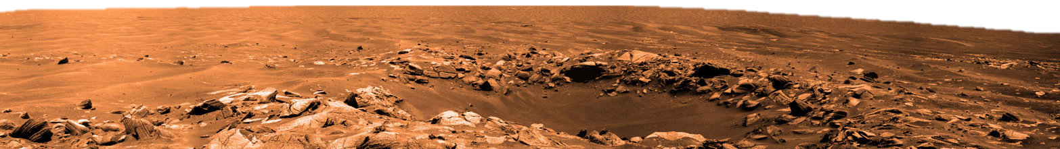
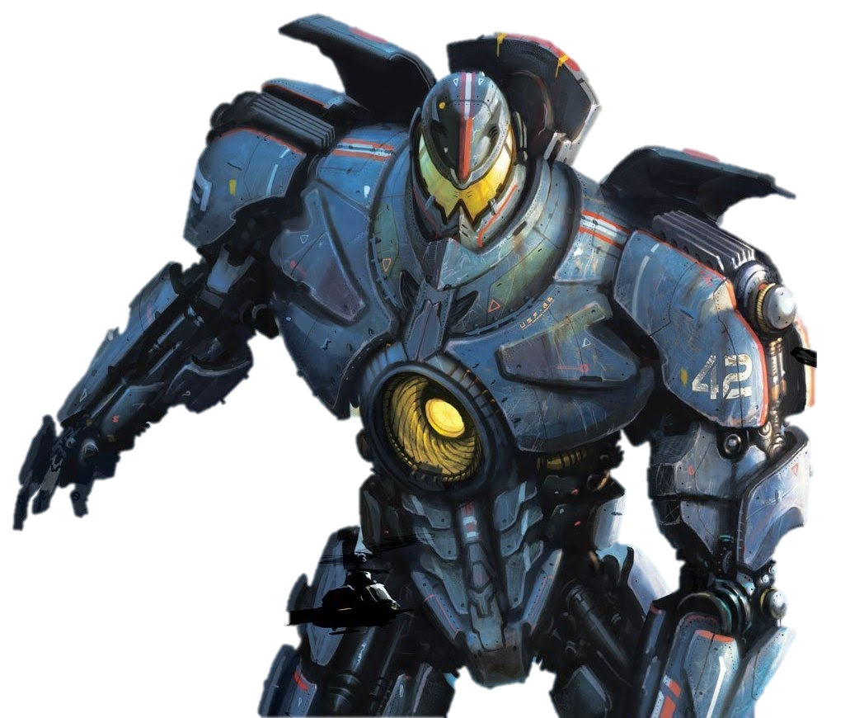
Transforming the Senses
Applications for Artificial Sensory Systems
Our application is just the beginning.
Empower prosthetic devices
Technology like Making Sense will restore
Experience new worlds
The introduction of artificial sensation will bring touch to new places. From the Martian to the microscopic, this technology will help users feel in places where it was never possible before!
Enhance human experiences
Surpass the impossible by expanding human potential and advancing the human condition.
BMES

